Slide 1
Building Movie Review Website IV
Week 12.

Slide 2
Objectives
Demonstrate how to build the basic architecture of a web application based on a Movie Review website;
Demonstrate how to build the web pages of a Movie Review website.

Slide 3
Tools Required
Visual Studio Code
Node.js
Browser
Google Chrome (recommended)
Mozilla Firefox

Slide 4
Creating the View…Continue

Slide 5
Adding Edit Comment Modal Window - edit-comments-modal.html
Watch the demo here
The Edit Comment design is rather similar to the Add New Comment modal window. The only difference is that the comment data that the user wants to edit are displayed.

Slide 6
Adding Edit Comment Modal Window - edit-comments-modal.html
<div class="modal fade" id="editCommentModal" tabindex="-1" role="dialog">
<div class="modal-dialog modal-lg" role="document">
<div class="modal-content">
<div class="modal-header bg-dark text-center">
<h3 class="modal-title text-light">Edit a Review</h3>
<button type="button" class="close bg-light" data-dismiss="modal">
<span>&times;</span>
</button>
</div>
<div class="modal-body px-5">
<form id="commentForm">
<div class="row" text-center id="editcommentBody">
<label for="nickname">Nickname</label>
<input type="text" id="editnickname" class="form-control" required>
<label for="userComments">Review</label>
<textarea id="edituserComments" required class="form-control form-rounded" rows="3" cols="100%"></textarea>
<label for="popcorn">Review</label>
<img src="images/popcorn_bw.png" class="editpop" value="1" onmouseover="rateIt(this)" />
<img src="images/popcorn_bw.png" class="editpop" value="2" onmouseover="rateIt(this)" />
<img src="images/popcorn_bw.png" class="editpop" value="3" onmouseover="rateIt(this)" />
<img src="images/popcorn_bw.png" class="editpop" value="4" onmouseover="rateIt(this)" />
<img src="images/popcorn_bw.png" class="editpop" value="5" onmouseover="rateIt(this)" />
</div>
<div class="modal-footer">
<button type="button" class="btn btn-primary" data-dismiss="modal" id="submitComment" onClick="updateComment()">Submit</button>
<button type="button" class="btn btn-secondary bg-dark" data-dismiss="modal">Close</button>
</div>
</form>
</div>
</div>
</div>
</div>

Slide 7
Adding Edit Comment Modal Window
To create the Edit Comment feature, we also need to create three JavaScript functions:
One to open the edit comment modal window with the comment data to be edited;
One to display the number of coloured popcorn images based on the rating given by the comment;
One to submit the updated comment to the server.

Slide 8
Adding Edit Comment Modal Window - comments.js
//This function will hide the existing modal and present a modal with the selected comment
//so that the user can attempt to change the username, rating or movie review
function editComment(element) {
var item = element.getAttribute("item");
currentIndex = item;
document.getElementById("editnickname").value = comment_array[item].username;
document.getElementById("edituserComments").value = comment_array[item].review;
console.log(comment_array[item].rating);
displayColorPopcorn('editpop', comment_array[item].rating);
}

Slide 9
Adding Edit Comment Modal Window - comments.js
Next, also in comments.js file, add the following function to display coloured popcorn image for the rating.
//This function displayS the correct number of colored popcorn
//based on the movie rating that is given in the user comment
function displayColorPopcorn(classname, num) {
var pop = document.getElementsByClassName(classname);
var classTarget = "." + classname;
for (let p of pop) {
p.setAttribute("src", popcornBWImage);
}
changePopcornImage(num, classTarget);
}

Slide 10
Adding Edit Comment Modal Window - comments.js
Lastly, also in comments.js file, add the following function to submit the comment data to the server.
//This function sends the Comment data to the server for updating
function updateComment() {
var response = confirm("Are you sure you want to update this comment?");
if (response == true) {
var edit_comment_url = comment_url + "/" + comment_array[currentIndex]._id;
var updateComment = new XMLHttpRequest(); // new HttpRequest instance to send request to server
updateComment.open("PUT", edit_comment_url, true); //The HTTP method called 'PUT' is used here as we are updating data
updateComment.setRequestHeader("Content-Type", "application/json");
comment_array[currentIndex].username = document.getElementById("editnickname").value;
comment_array[currentIndex].review = document.getElementById("edituserComments").value;
comment_array[currentIndex].rating = rating;
updateComment.onload = function() {
fetchComments();
};
updateComment.send(JSON.stringify(comment_array[currentIndex]));
}
}

Slide 11
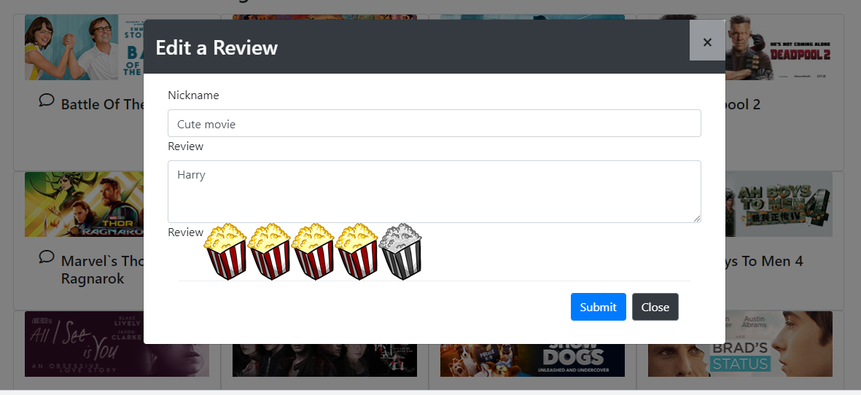
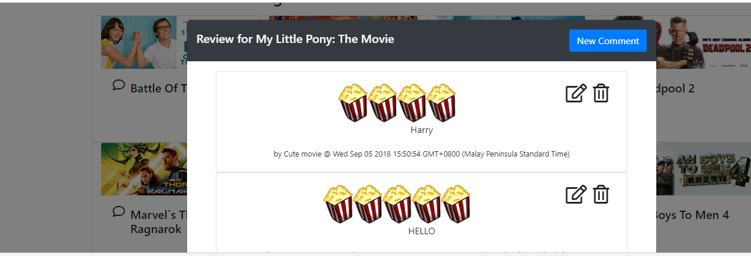
Test the Edit Comment Feature
Test the Edit Comment feature by choosing a movie and click on the Edit icon to update one of its comment.
Select the movie comment again to check if your comment is updated.

Slide 12
Adding Delete Comment Feature
We are now left with the last feature for comments – Delete.
The Delete function is activated by clicking on the Delete icon in the Comments modal window.

Slide 13
Adding Comments Modal Window
In comments.js, add the following deleteComment() function.
//This function deletes the selected comment in a specific movie
function deleteComment(element) {
var response = confirm("Are you sure you want to delete this comment?");
if (response == true) {
var item = element.getAttribute("item"); //get the current item
var delete_comment_url = comment_url + "/" + comment_array[item]._id;
var eraseComment = new XMLHttpRequest();
eraseComment.open("DELETE", delete_comment_url, true);
eraseComment.onload = function() {
fetchComments();
};
eraseComment.send();
}
}

Slide 14
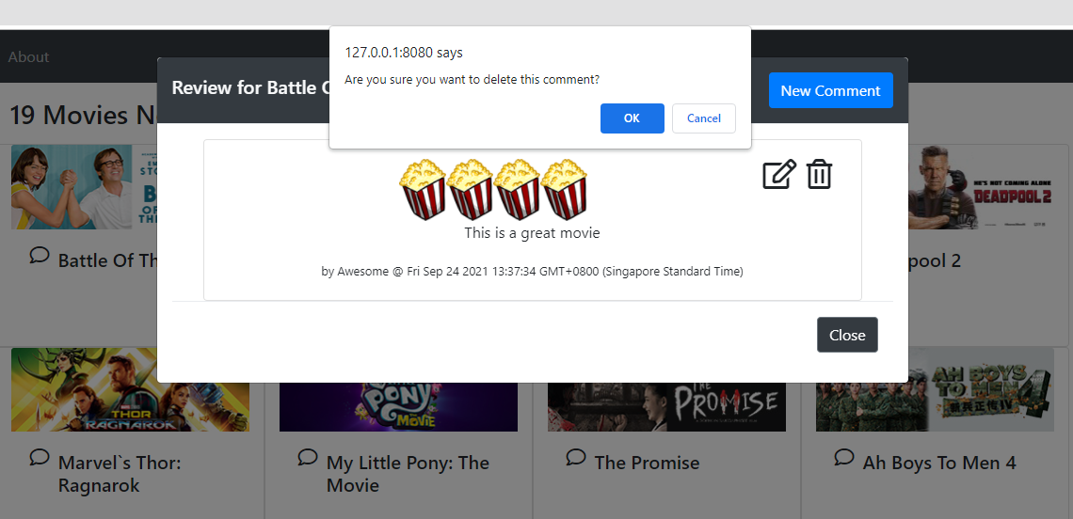
Test the Comments
Reload the index.html page and select a movie comment to view. In the Comments modal window, click on the Delete icon and then confirm to delete.
Select the movie comment again to check if the comment has been deleted.

Slide 15
Congratulations!
Congratulations! You have now successfully created a Pure Movie Review web client that interacts with a Server-side Web API.

Slide 16
The End

